Slide 1
AppScan Dynamic Analyzer

Slide 2
AppScan Dynamic Analyzer
Security issues of web applications
37 security issues
Scan report of detected security issues.

Slide 3
Tutorial
https://github.com/ongj/appscan
http://ongj.github.io/appscan/

Slide 4
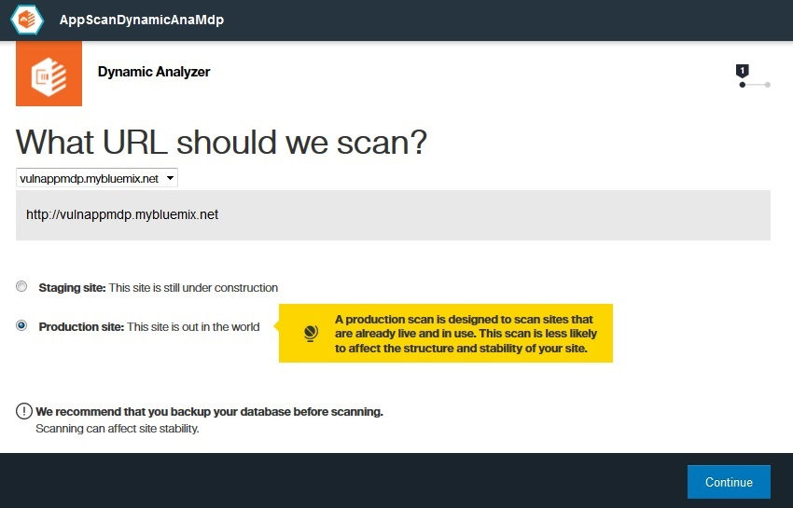

Slide 5
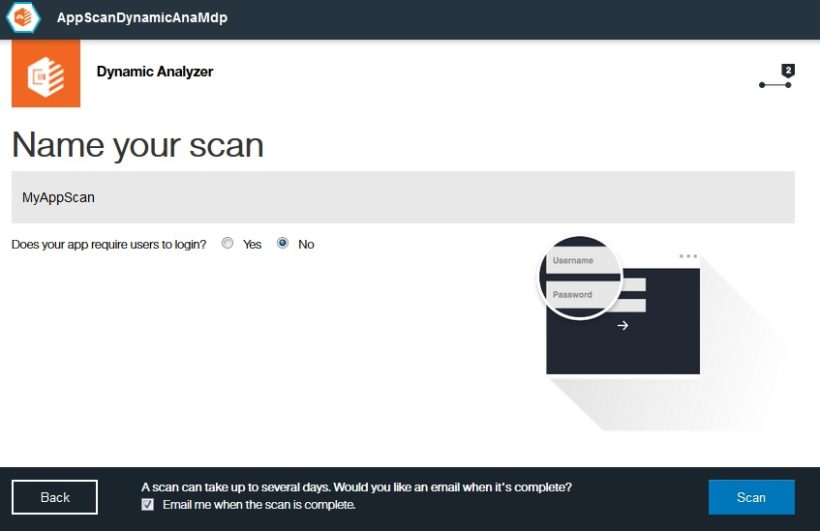

Slide 6
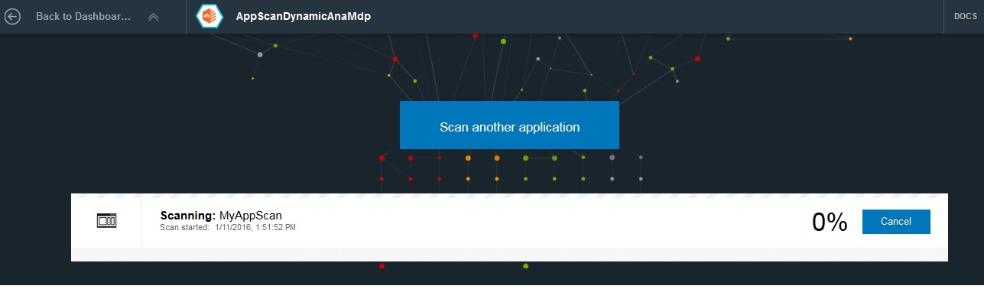

Slide 7
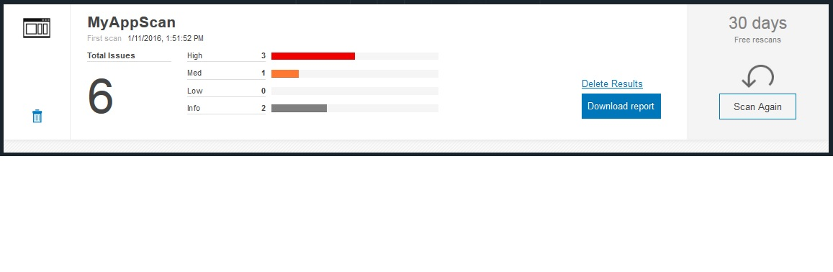

Slide 8
Results
Scan report shows different security issues detected in the web application.
Detailed explanation for each issue or vulnerability detected.
Fix recommendations for the security issues are given.

Slide 9
Purpose of AppScan Dynamic Analyzer
Helps keep web applications deployed to IBM Bluemix secure.
Suggests fix recommendations to the security issues detected.

Slide 10
Thank You

